Slide 1
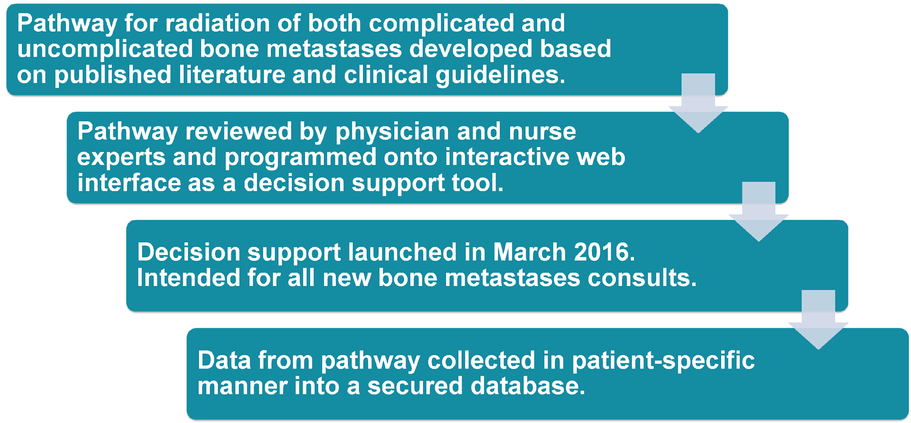
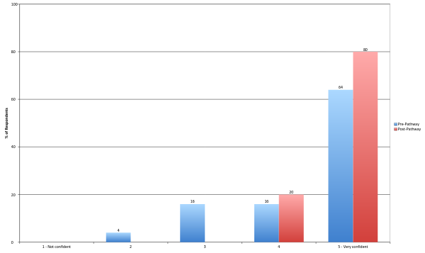
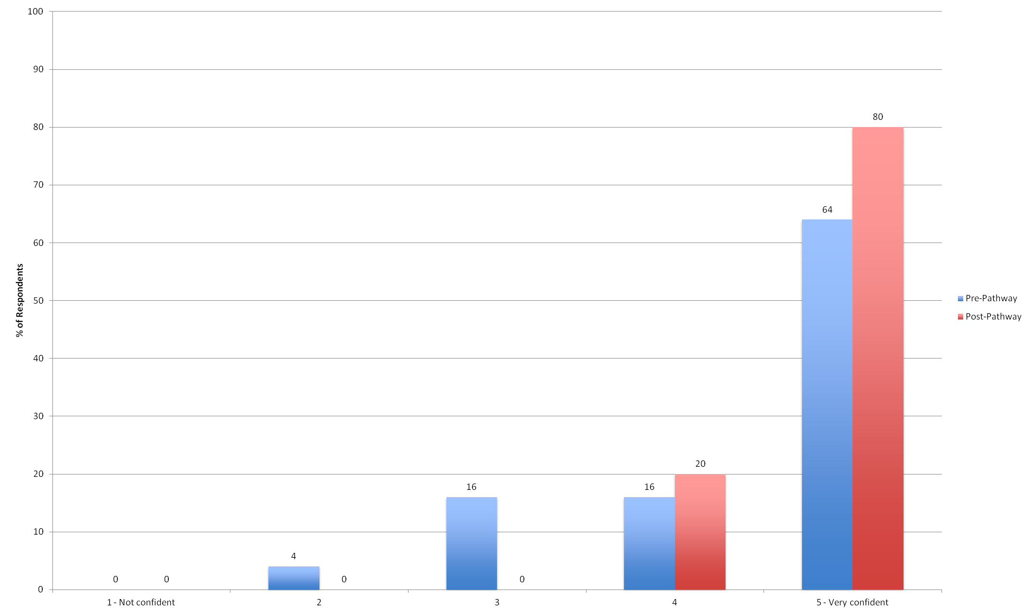
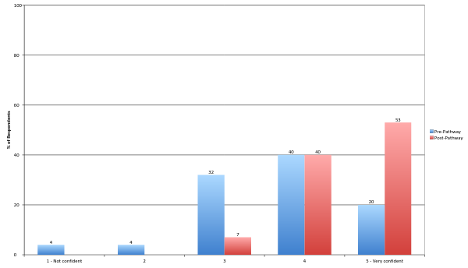
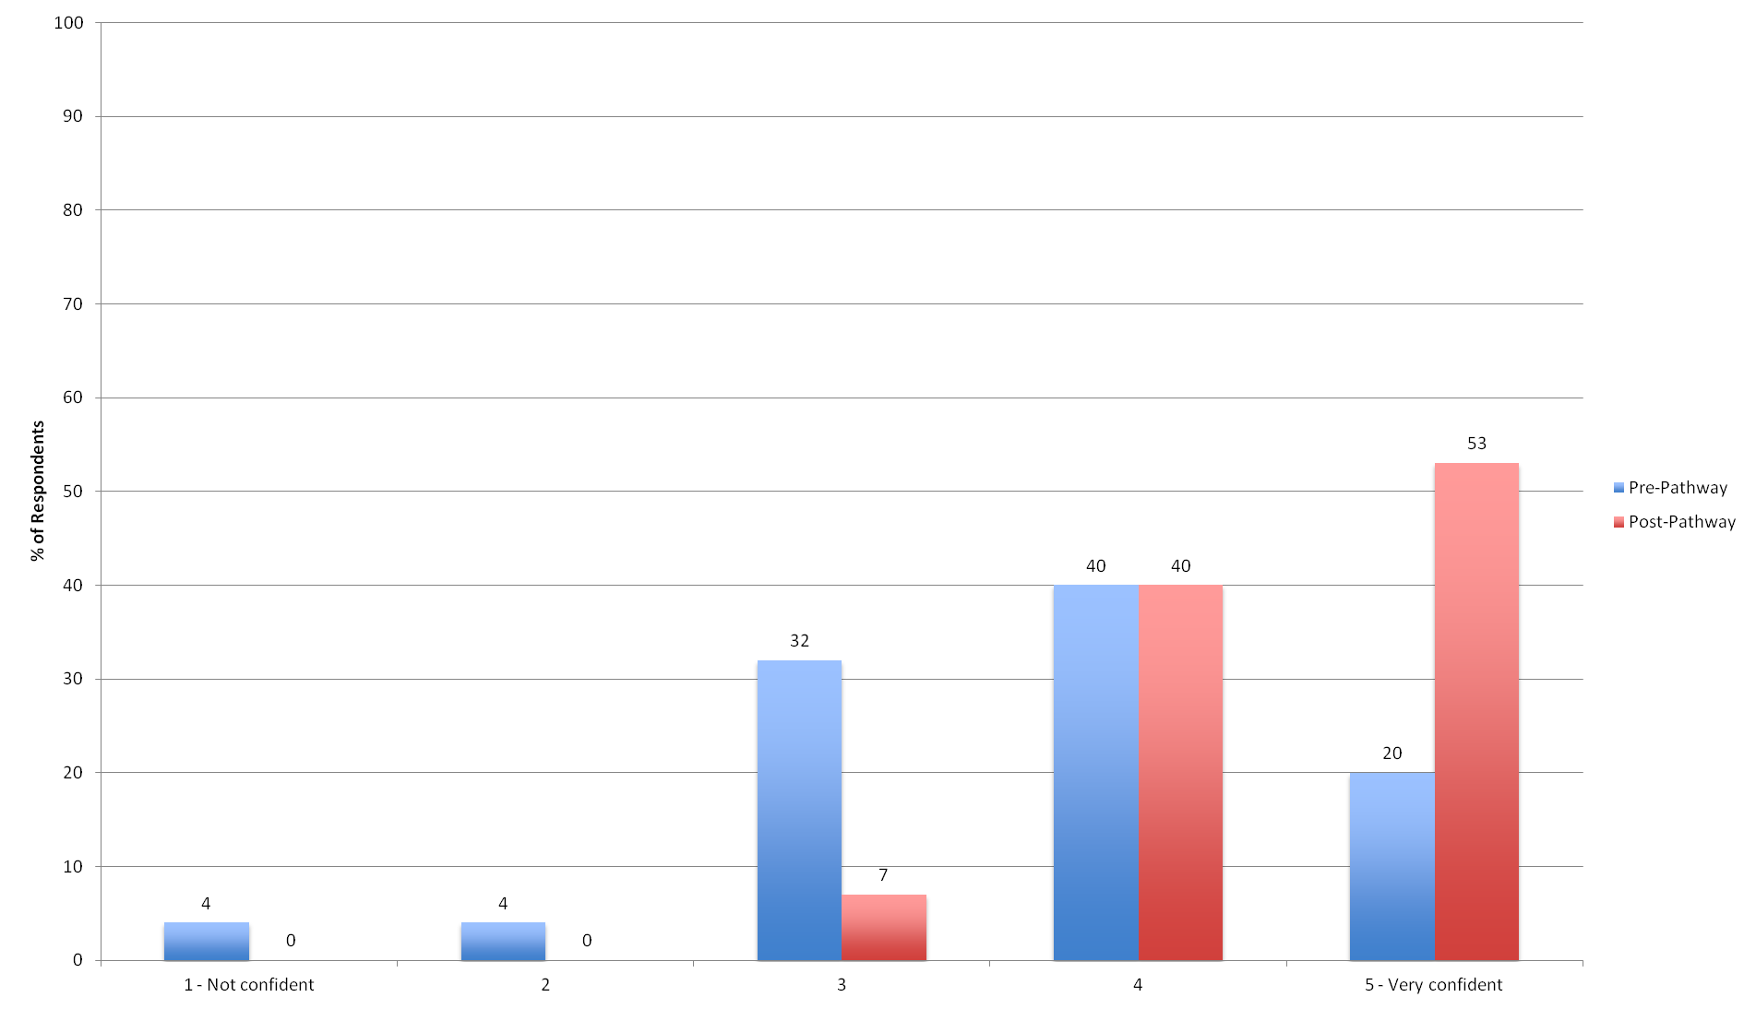
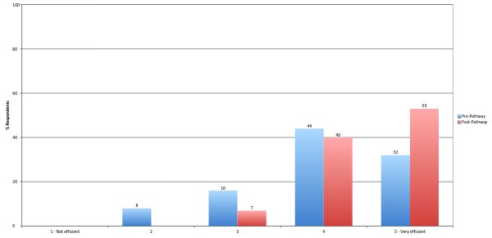
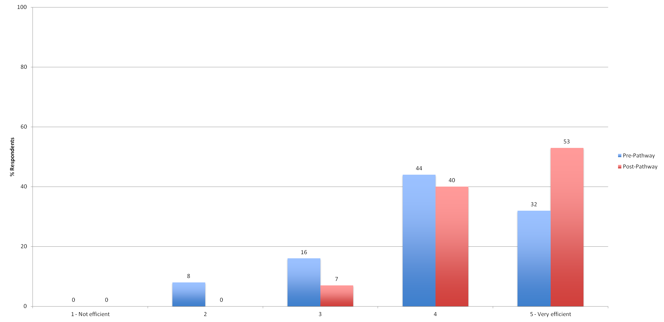
Development and Implementation of a Clinical Pathway for Radiation of Bone Metastases
on a Palliative Radiation Oncology Service
Lisa S. Rotenstein BA^{1,3}Joseph Killoran PhD, Tracy A. Balboni MD, Monica S. Krishnan MD, Allison Taylor NP, Neil E Martin MD
¹ Harvard Medical School, Boston, MA,
BACKGROUND
DEVELOPMENT AND ROLLOUT
Clinical pathways increase compliance with treatment guidelines.
Although ASTRO/ACR recommend single-fraction radiation therapy for uncomplicated bone metastases, implementation is variable.
“Took time, but clearly worth it.”
“Overall I thought it was helpful, more for confirmation that doing a short fractionation was indicated”
“The pathway sometimes changed recommendations.”
ORGANIZATIONAL CONTEXT
The Brigham and Women’s Hospital Supportive and Palliative Radiation Oncology Service (SPRO) was founded in 2011.
On a rotating basis it involves 54 physicians, residents, nurse practitioners, and fellows.
ANALYSIS
Compliance was measured by comparing all patient-specific pathway entries to all patients whose consultation was billed with an ICD-10 code of c79.51 or an ICD-9 code of 198.5
Pre and post-implementation appropriate single fraction rates were compared by assessing 1) % of patients seen from March – August 2015 who received appropriate 8 Gy x 1, as determined by post-hoc entry of their information into our pathway, and 2) % of patients seen from March – August 2016 who received 8 Gy x 1 when recommended.
OBJECTIVES
To develop an electronic decision support tool for bone metastases radiation.
To assess departmental perceptions of clinical pathways and bone metastases radiation practices pre and post-implementation of said decision support tool.
To determine the effects of the decision support tool on the practice patterns of our institution’s supportive and palliative radiation oncology service (SPRO).
COMPLIANCE AND EFFECTS
CONCLUSIONS
An electronic decision support tool for bone metastases radiation was well accepted on BWH’s Palliative Radiation Oncology Service.
It made providers more confident in their recommendations.
It significantly increased appropriate single fraction radiation prescription.

